Slide 1
Reading Skill Validation
(Cloze Procedure)
Control (120)
Omit 1st Word
PIL I
12
Sentences
Advice List (120)
Cloze Map (120)
Omit 2nd Word
Control (120)
PIL II
12
Sentences
Advice List (120)
Cloze Map(120)
Omit 3rd Word
Control (120)
PIL III
12
Sentences
Advice List (120)
Omit 4th Word
Cloze Map (120)

Slide 2
3 PILS
EXPT 1
Task1 – Complete 3 sentences(1 of 5 possible variations)
Replacing 1st,5th ...
Replacing 2nd,6th...
Replacing 3rd,7th...
Replacing 4th,8th...
Replacing 9th,14th...
To create a full Cloze Map for the 3rd Group & validate the reviser reading skill.
Analyse:
Learning & fatigue effects
Technique effect on readability
Correlation: task time vs difficulty level
Demographic effect on readability
Sentences >15worsds
Group 1:
No Support
9 Sentences per leaflet:
3 difficulty levels
3 sentences per level
Relevant Sentences:
EQIP Category
Group 2:
Tip List
Readability Score Agreement
Task2 – Revise 3 sentences (1 of 6 possible orders)
Easy/Medium/Hard
Easy/Hard/Medium
Medium/Easy/Hard
Medium/Hard/Easy
Hard/Easy/Medium
Hard/Medium/Easy
To calculate learning & fatigue effects
Analyse:
Assessment of reviser reading skill
Learning & fatigue effects
Cloze viability to identify jargon
Correlation: task time vs difficulty level
Demographic effect on readability
Group 3:
Cloze Map
EXPT2

Slide 3
EXPT1
Output: Revised Sentences (3x9x9)
Analyse:
Which method gives the best support to PIL revisers?
For which kind of sentences is crowdsourcing revisions useful?
How to select PIL revisers?
Expt 2:
_________________
Select 6 proposed revisions for each sentence:
3 Lowest readability score.
3 Random revisions
Ask PIL Authors to rate the revisions:
Completeness
Tone
Readability
Importance

Slide 4
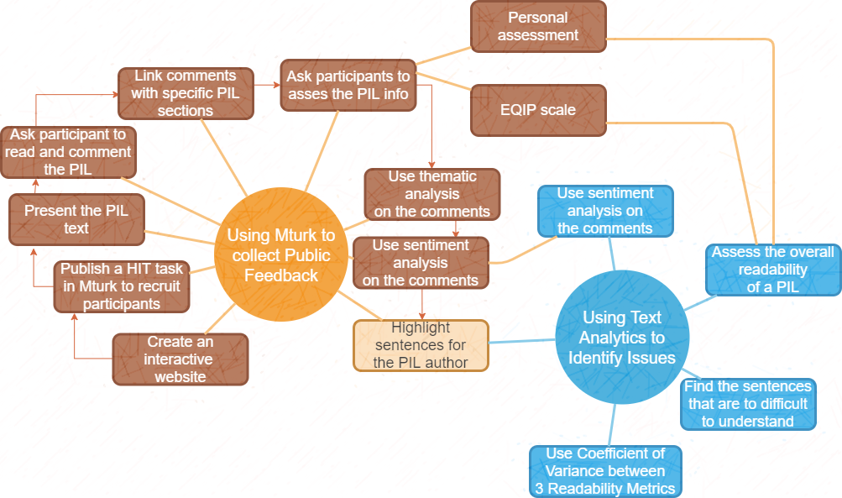

Slide 5
Compare the PIL feedback from a face-to-face group with feedback gathered through MTurk
Content analysis
Assess if a Webtool can be used to collect PIL feedback
Thematic analysis
Demographics
Association: Quality Perception-Comprehension
Employ content analysis to identify PIL sentences that require higher reading skill than the average in general population
Assess if a Webtool can to identify hard to read sentences
Performance
Readability Scores
Coefficient of Variance
Present a selection of sentence with low readability to MTurk participants to revise them.
PIL section sentiment
Assess if a Webtool can be used revise hard to read sentences
Revision Readability
Association: Sentence Readability - Performance
Present proposed revisions to the original sentences to Mturk participants and ask to grade their viability
Association: Participant Skill - Performance
Assess if a Webtool can be used validate proposed revisions
Association: Learning & Fatigue Effects - Performance

Slide 6
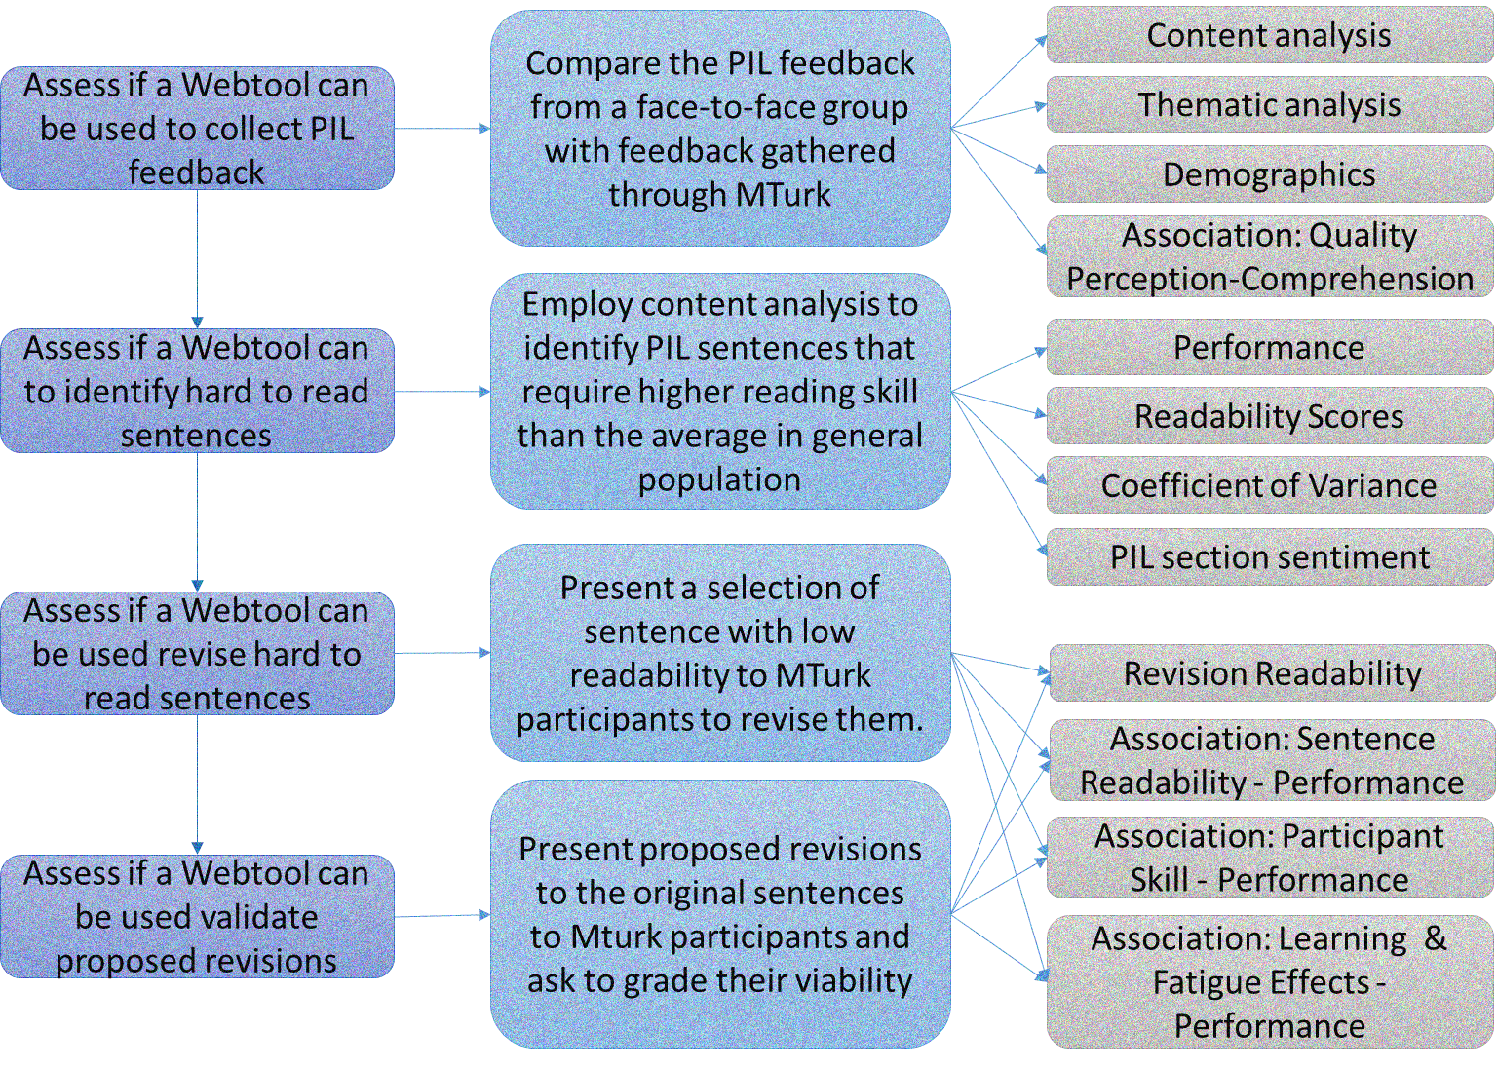

Slide 7
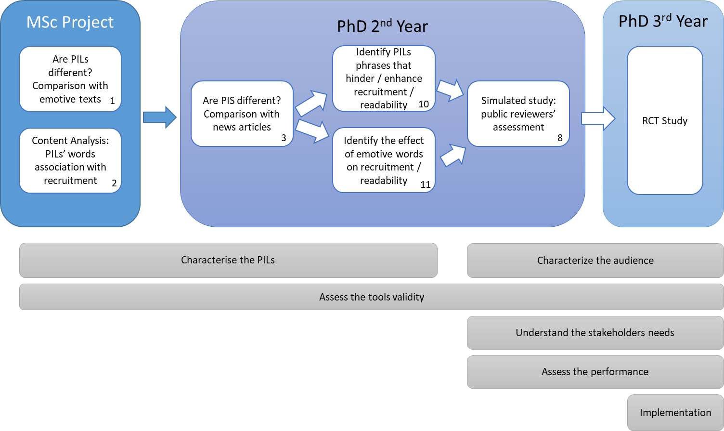

Slide 8
